Slide 1

Anthropology Now: How scholars and companies use anthropological data and why it matters
Marc Kissel
Appalachian State University
AAA, San Jose 2018

Slide 2
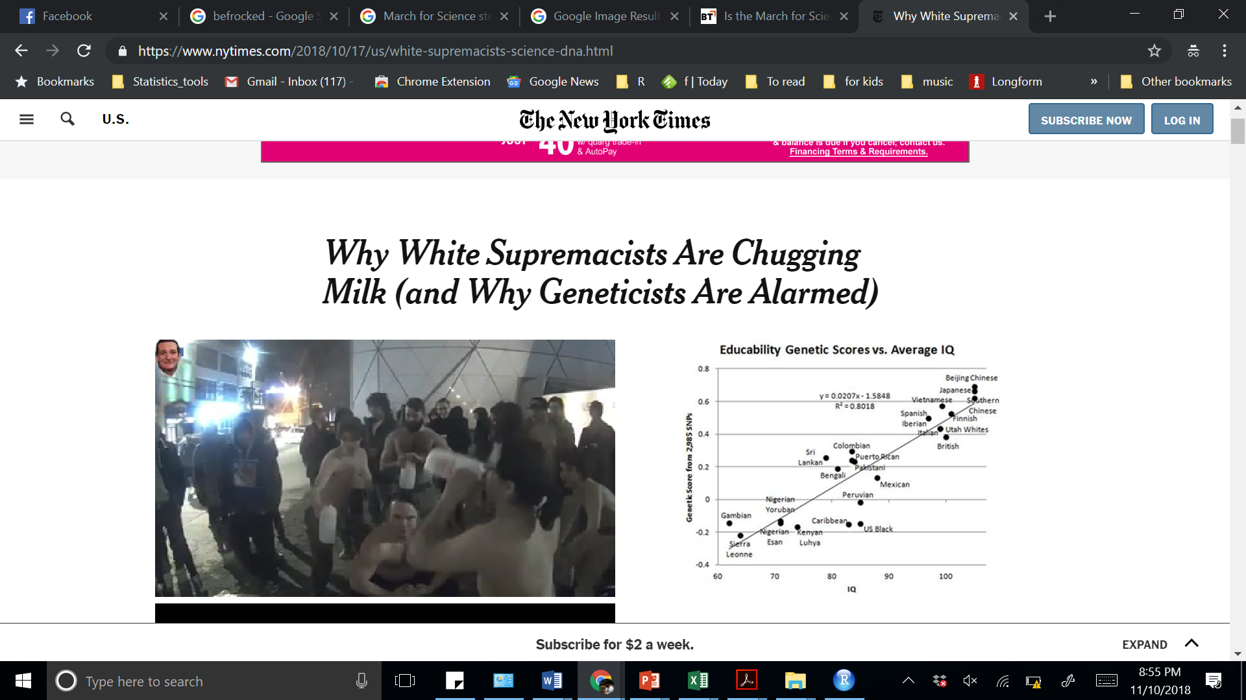

What would we learn if we turned to some popular discussions of human behavior?

Slide 3
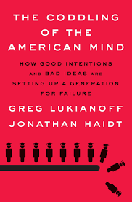
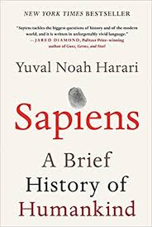
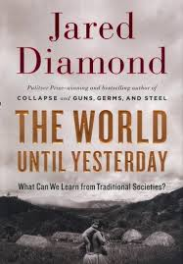


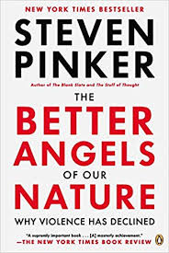
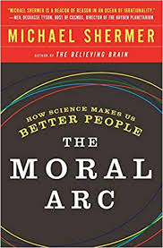
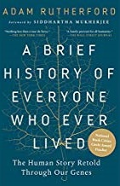
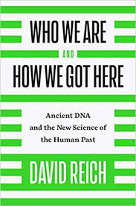
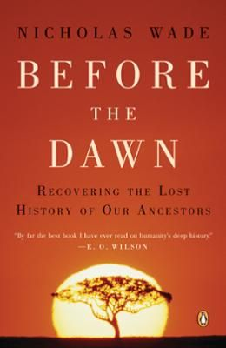


Slide 4
Problematic Themes:
Often oversimplify human behavior & misunderstand evolutionary theory
Assume reductionist models of genotype-phenotype interaction
The West is best
Assume that males are driving much of the evolutionary story
“The larger size, strength, and upper-body mass of men is a zoological giveaway of an evolutionary history of violent male-male competition”

Slide 5
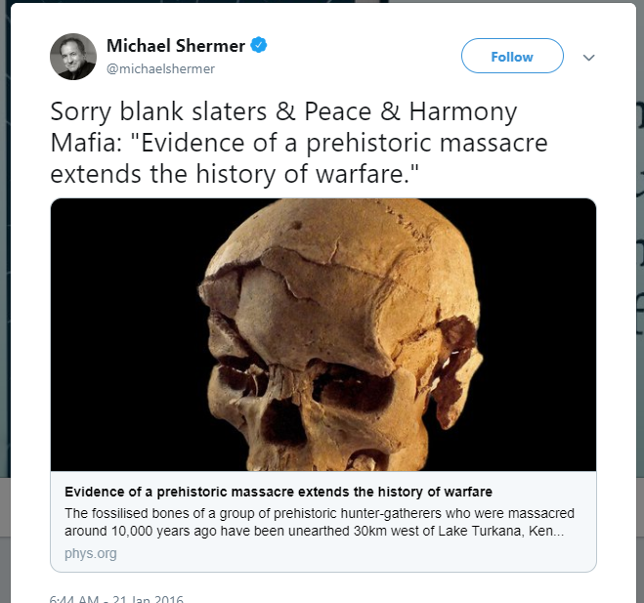
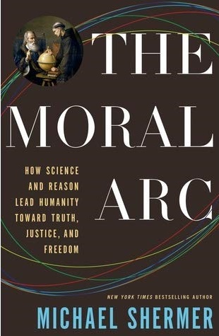
if you lived 10,000 years ago and were a man “there was about a one in four chance that you would die violently” (2015: 92).

Slide 6
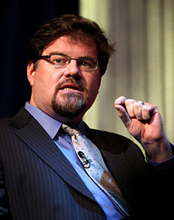
“This is no longer a debated point among most serious scholars. People who think we once lived in glorious harmony with each other–and the environment–aren’t scientists, they’re poets and propagandists. The evidence for mankind’s blood-soaked past can be found in the archaeological record, DNA analysis, the writings of ancient commentators, and historians, and the firsthand reports of those remaining societies that have so far resisted modernity” (2018: 31).”
“This is no longer a debated point among most serious scholars. People who think we once lived in glorious harmony with each other–and the environment–aren’t scientists, they’re poets and propagandists. The evidence for mankind’s blood-soaked past can be found in the archaeological record, DNA analysis, the writings of ancient commentators, and historians, and the firsthand reports of those remaining societies that have so far resisted modernity” (2018: 31).”
CC BY-SA 3.0, Gage Skidmore

Slide 7

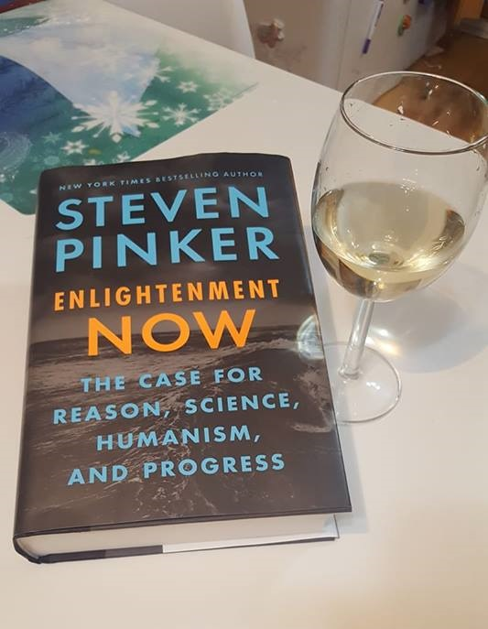

Slide 8
Excerpts:
"Poverty, too, needs no explanation. In a world governed by entropy and evolution, it is the default state of humankind" (Pinker 2018)
`
“with the usual first-world ingratitude, moaner social critics rail against the obesity epidemic with a level of outrage that might be appropriate for famine (that is, when they are not railing against fat-shaming, slender fashion models, or eating-disorders). Though obesity is a public health problem, by the standards of history its’s a good problem to have” (Pinker 2018: 69).

Slide 9
Graphs fromm Inequolty
Chetty et al 2016

Slide 10
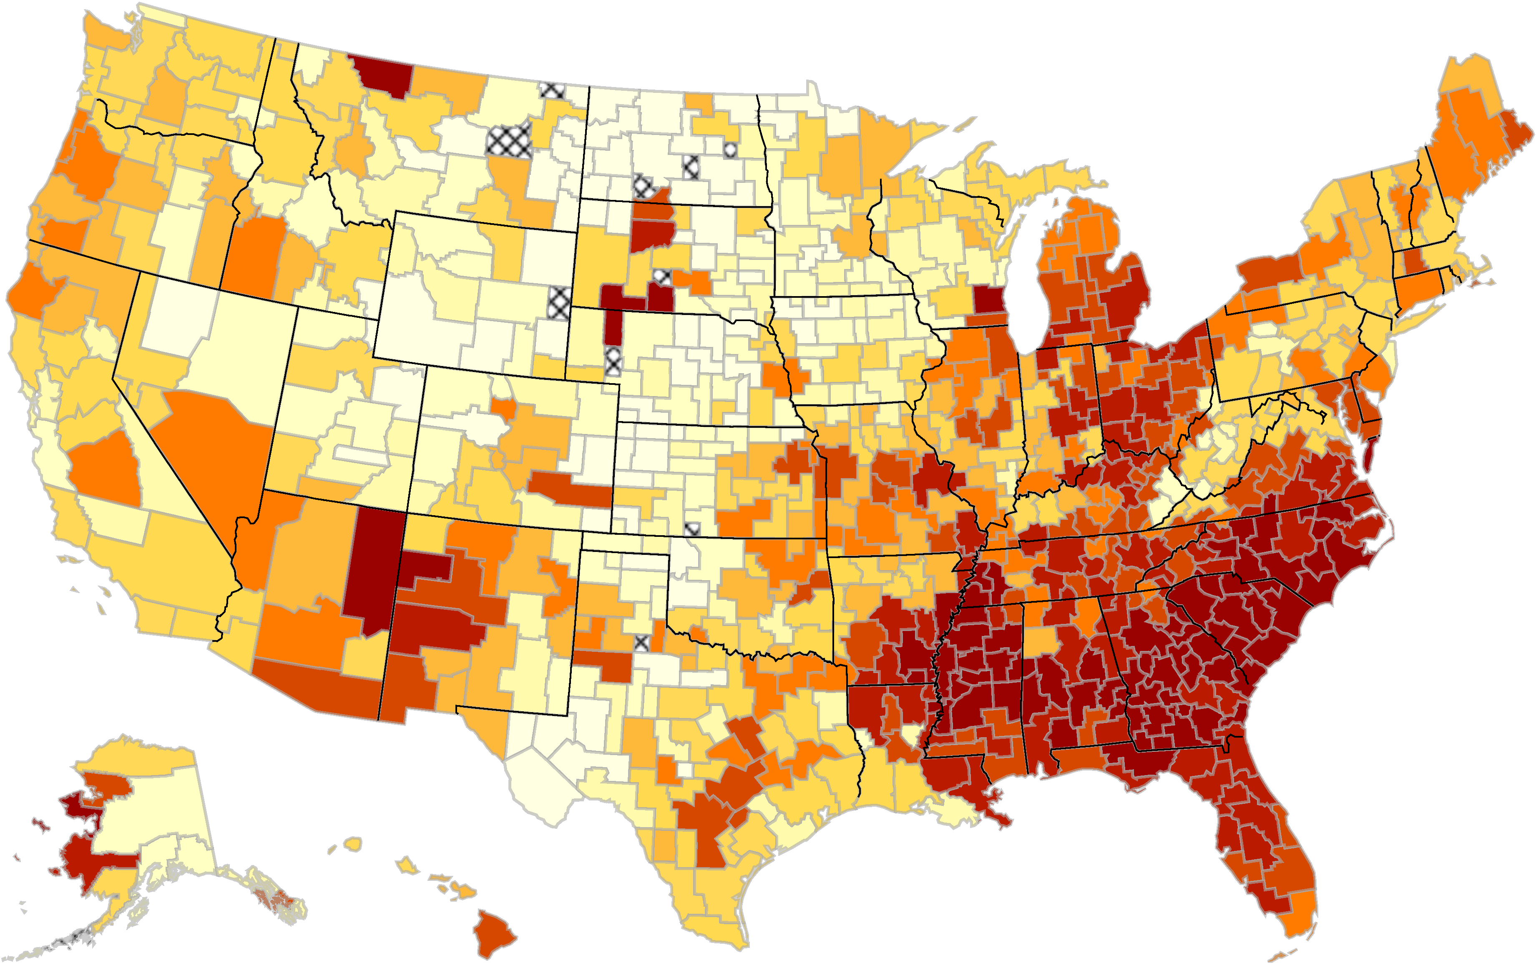
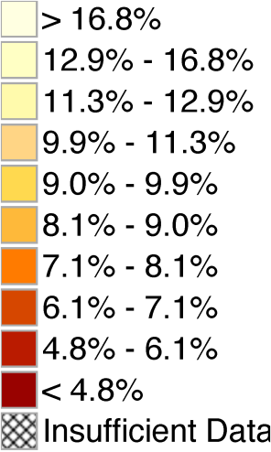
www.equality-of-opportunity.org

Slide 11
With the usual first-world ingratitude, modern social critics rail against the obesity epidemic with a level of outrage that might be appropriate for famine (that is, when they are not railing against fat-shaming, slender fashion models, or eating-disorders). Though obesity is a public health problem, by the standards of history its’s a good problem to have”
today, the poor are likely to be as overweight as their employers, and dressed in the same fleece, sneakers, and jeans. The poor used to be called the have-nots. In 2011, more than 95 percent of American households had electricity, running water, flush toilets, a refrigerator, a stove, and a color tv. (a century and a half before, the Rothschilds, Astors, and Vanderbelts had none of these things….The richer have gotten richer, but their lives haven’t gotten that much better…the lives of the poor are improving more rapidly than the lives of the rich

Slide 12
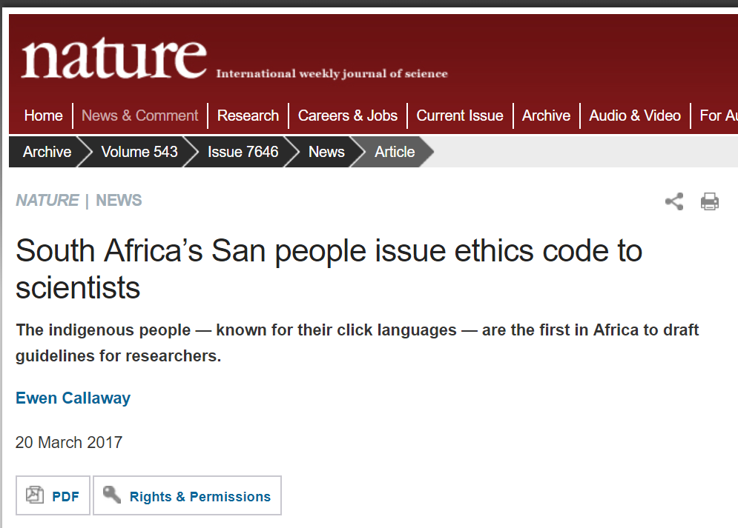
Ethnography
Though unlettered hunters, headers, and peasants are fully human, anthropologists often comment on their orientation to the present, the local, the physical. To be aware of one's country and its history of the diversity of customs and beliefs across the globe and through the ages, of the blunders and triumphs of past civilizations, of the microcosms of cells and atoms and the macrocosms of planets and galaxies, of the eternal reality of number and logic and pattern--such awareness truly lifts us to a higher plane of consciousness. It is a gift of belonging to a brainy species with a long history."
“a well-studied contemporary hunter-gatherer tribe, the Hadza of Tanzania, who live in the ecosystem where modern humans first evolved and probably preserve much of their lifestyle, extract 3,000 daily calories per person from more than 880 species
“The San hunter-gatherers of the Kalahari Desert (the ‘Bushmen’), one of the world’s most ancient cultures”

Slide 13


Physical scientists, unfortunately, often consider themselves experts in political psychology

Slide 14
Physical scientists, unfortunately, often consider themselves experts in political psychology

Slide 15
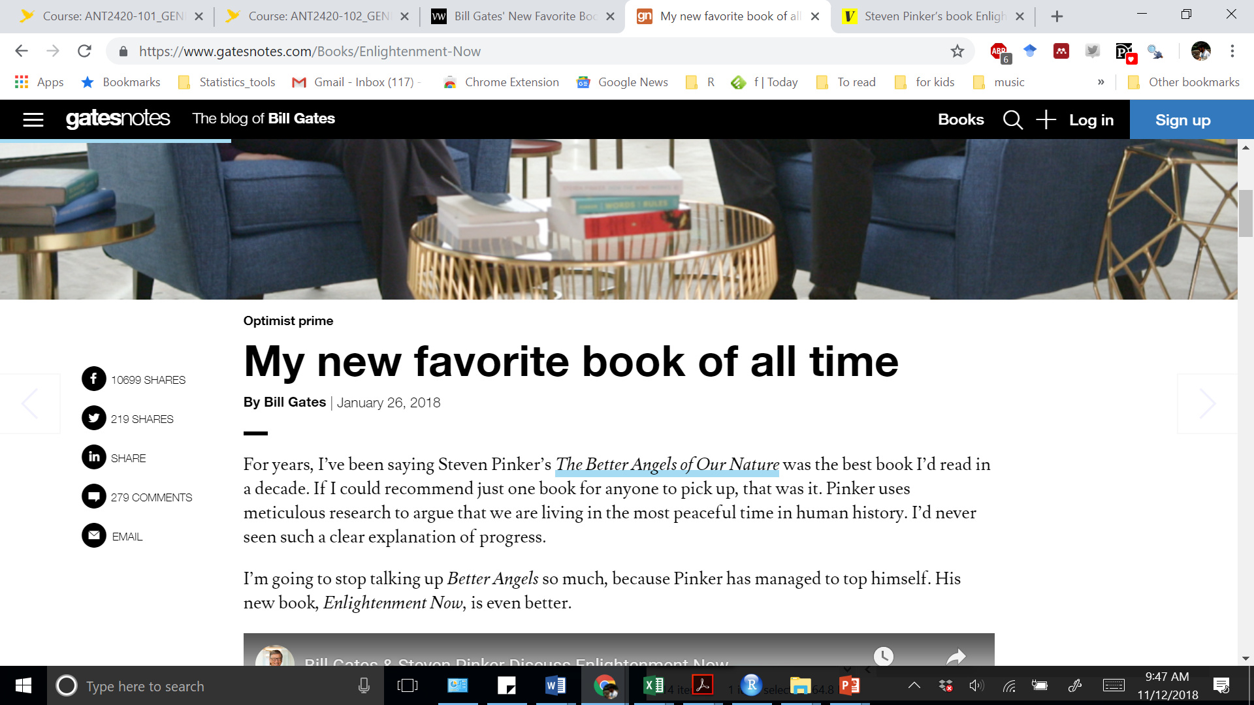
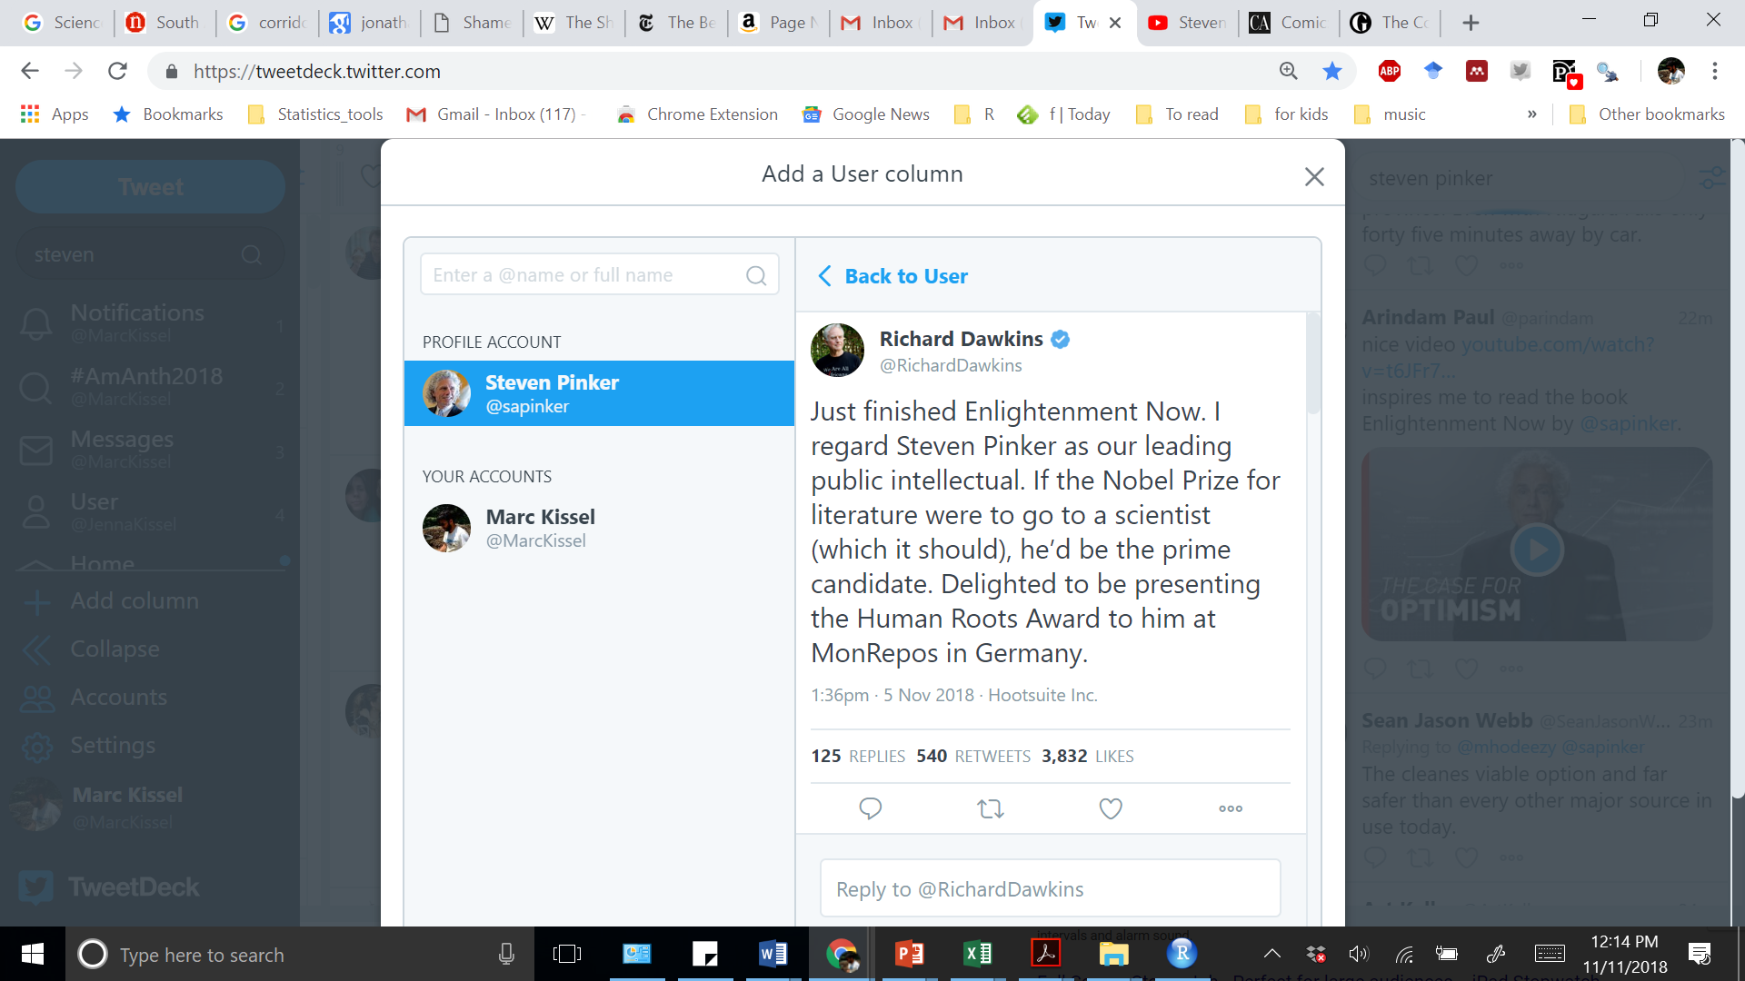
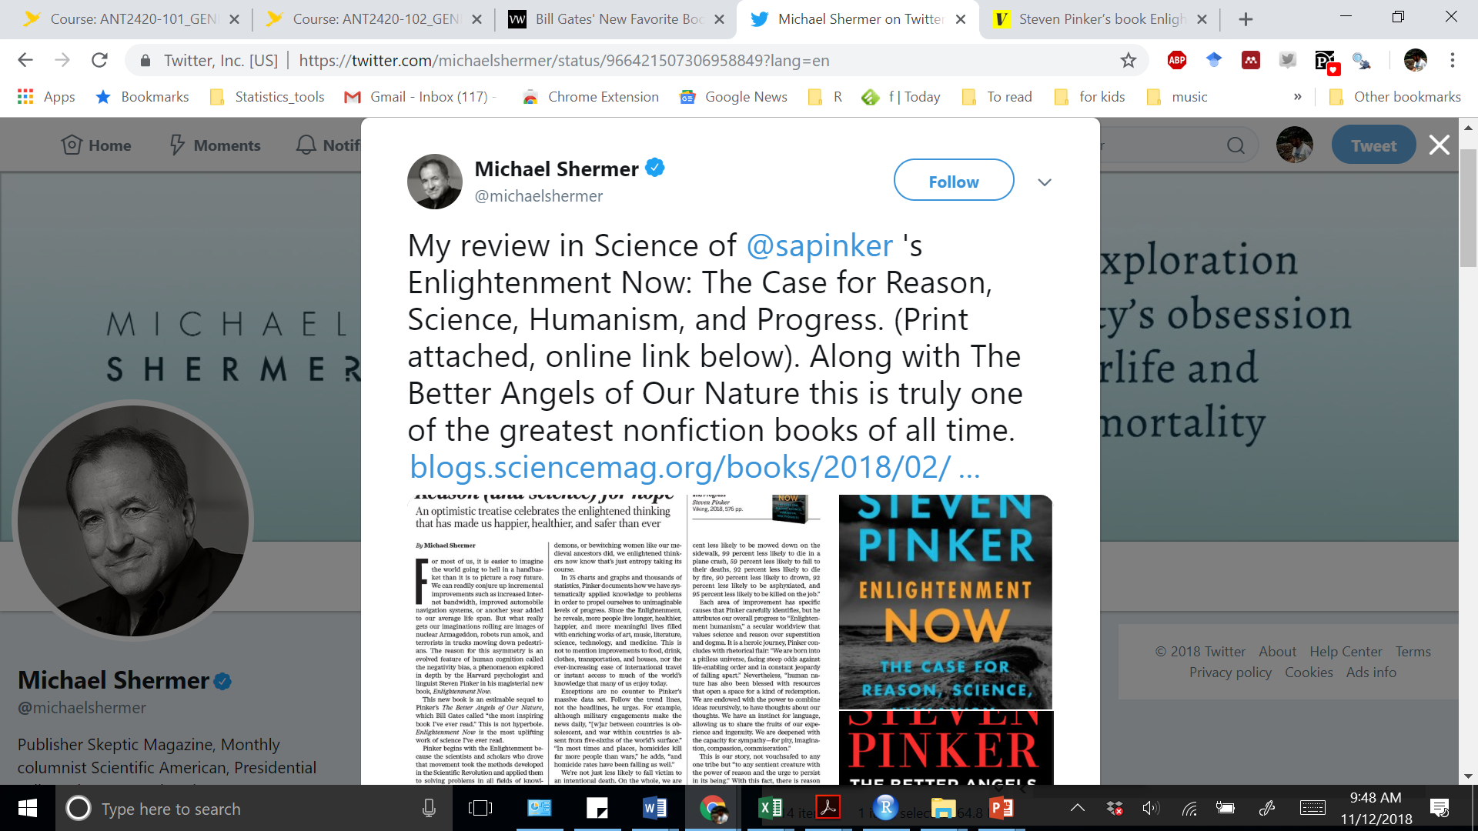
Why?

Slide 16

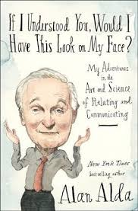
We are lucky that people are fundamentally interested in what we do!
Books like these get read by the public/policy makers
Citation circles among the “intellectual dark web”

